Slide 1
Applications of hash table in Merkle tree
ADVANCED DATA STRUCTURES

Slide 2
GROUP MEMBERS
Name | Roll No.
Medini Patil | 222049
Mohit Patil | 222050
Mrunmai Patil | 222051
Sakshi Patil | 222052
Sujit Patil | 222053

Slide 3
Merkle Tree
Merkle tree is a fundamental part of blockchain technology. It is a mathematical data structure composed of hashes of different blocks of data, and which serves as a summary of all the transactions in a block. Merkle Tree is also known as Hash Tree.
Merkle trees are used in distributed systems for efficient data verification. They are efficient because they use hashes instead of full files. Hashes are ways of encoding files that are much smaller than the actual file itself. Currently, their main uses are in peer-to-peer networks such as Tor, Bitcoin, and Git.

Slide 4


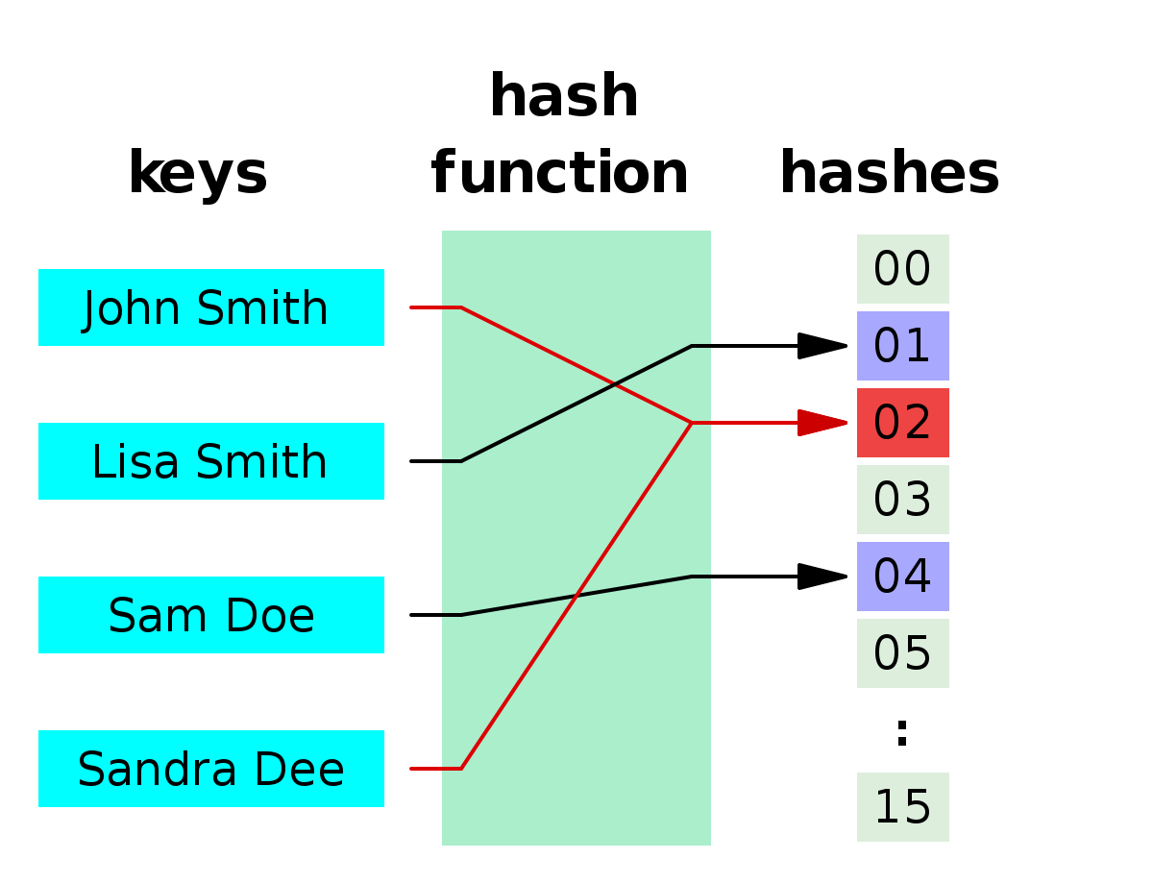
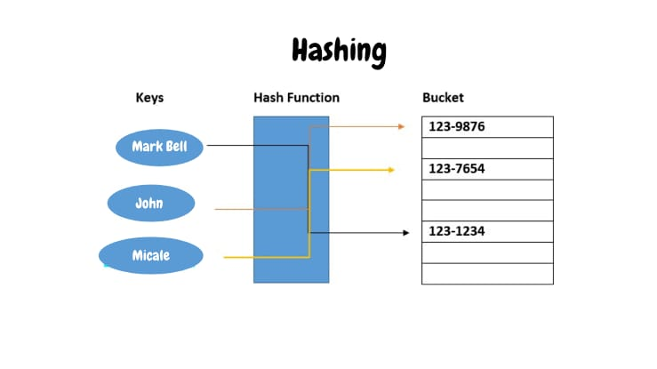
Hash Functions: So before understanding how Merkle trees work, we need to understand how hash functions work. A hash function maps an input to a fixed output and this output is called hash. The output is unique for every input, and this enables fingerprinting of data. So, huge amounts of data can be easily identified through their hash.

Slide 5
How do Merkle trees work?
A Merkle tree stores all the transactions in a block by producing a digital fingerprint of the entire set of transactions. It allows the user to verify whether a transaction can be included in a block or not.
Merkle trees are created by repeatedly calculating hashing pairs of nodes until there is only one hash left. This hash is called the Merkle Root, or the Root Hash. The Merkle Trees are constructed in a bottom-up approach.
Every leaf node is a hash of transactional data, and the non-leaf node is a hash of its previous hashes. Merkle trees are in a binary tree, so it requires an even number of leaf nodes. If there is an odd number of transactions, the last hash will be duplicated once to create an even number of leaf nodes.

Slide 6
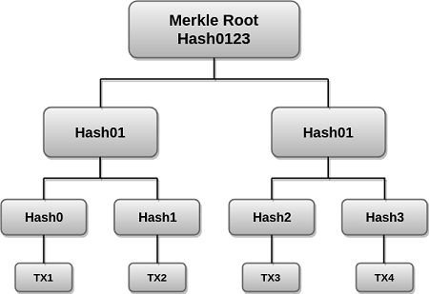
Hash01
Hash23
The above example is the most common and simple form of a Merkle tree, i.e., Binary Merkle Tree. There are four transactions in a block: TX1, TX2, TX3, and TX4. Here you can see, there is a top hash which is the hash of the entire tree, known as the Root Hash, or the Merkle Root. Each of these is repeatedly hashed, and stored in each leaf node, resulting in Hash 0, 1, 2, and 3.
Consecutive pairs of leaf nodes are then summarized in a parent node by hashing Hash0 and Hash1, resulting in Hash01, and separately hashing Hash2 and Hash3, resulting in Hash23. The two hashes (Hash01 and Hash23) are then hashed again to produce the Root Hash or the Merkle Root.

Slide 7
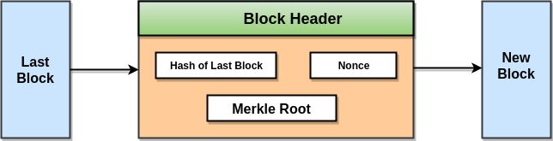
How do Merkle trees work?
Merkle Root is stored in the block header. It contains the hash of the last block, a Nonce, and the Root Hash of all the transactions in the current block in a Merkle Tree. So having the Merkle root in block header makes the transaction tamper-proof. As this Root Hash includes the hashes of all the transactions within the block, these transactions may result in saving the disk space.
The Merkle Tree maintains the integrity of the data. If any single detail of transactions or order of the transaction's changes, then these changes reflected in the hash of that transaction. This change would cascade up the Merkle Tree to the Merkle Root, changing the value of the Merkle root and thus invalidating the block.

Slide 8
Benefits of Merkle Tree in Blockchain
Merkle trees provide four significant advantages -
Validate the data's integrity: It can be used to validate the data's integrity effectively.
Takes little disk space: Compared to other data structures, the Merkle tree takes up very little disk space.
Tiny information across networks: Merkle trees can be broken down into small pieces of data for verification.
Efficient Verification: The data format is efficient and verifying the data's integrity takes only a few moments.

Slide 9
Why Is It Essential to Blockchain?
Think of a blockchain without Merkle Trees to get a sense of how vital they are for blockchain technology.
If Bitcoin didn't include Merkle Trees, every node on the network would have to retain a complete copy of every single Bitcoin transaction ever made. One can imagine how much information that would be.
Any authentication request on Bitcoin would require an enormous amount of data to be transferred over the network: therefore, you'll need to validate the data on your own.
To confirm that there were no modifications, a computer used for validation would need a lot of computing power to compare ledgers.

Slide 10
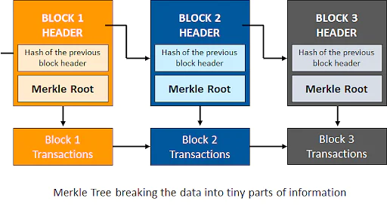
Why Is It Essential to Blockchain?
Merkle Trees are a solution to this issue. They hash records in accounting, thereby separating the proof of data from the data itself.
Proving that giving tiny amounts of information across the network is all that is required for a transaction to be valid.
Furthermore, it enables you to demonstrate that both ledger variations are identical in terms of nominal computer power and network bandwidth.

Slide 11



